Slide 1
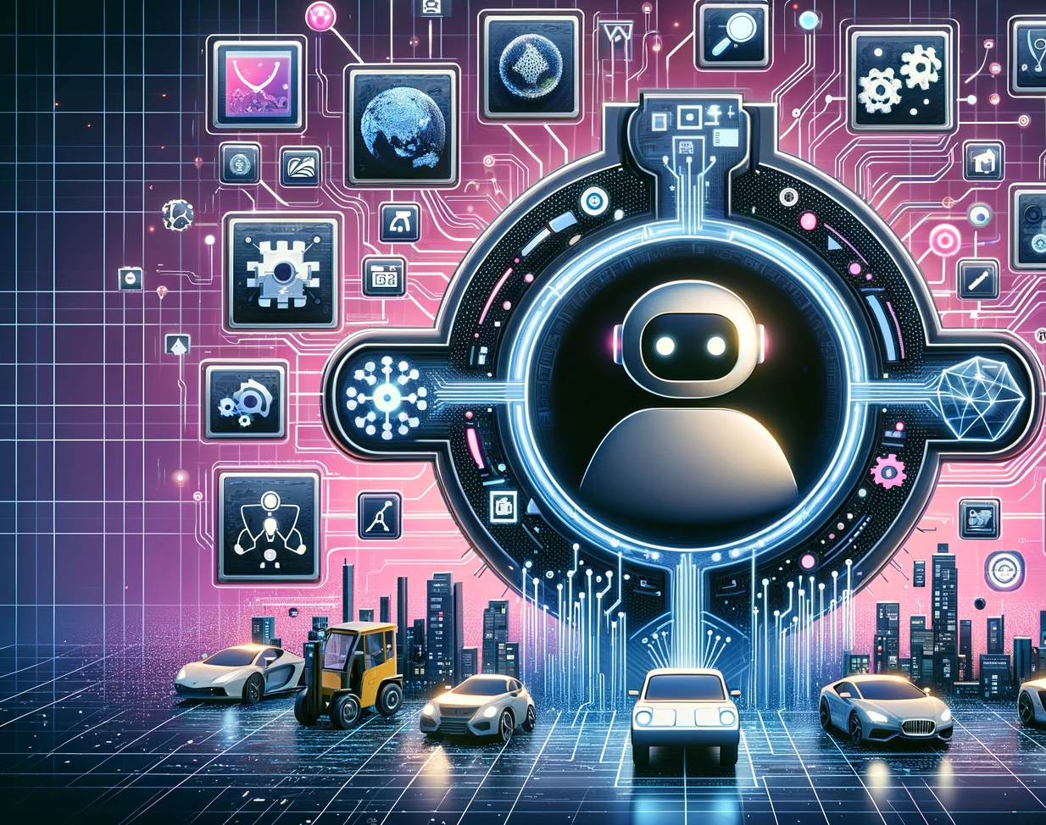
以大型語言 模型打造的 AI Agent
李宏毅
Notes:
TODO: Add figure 01
哥雷姆
======
Typically in AI, an agent refers to an artificial entity capable of perceiving its surroundings using sensors, making decisions, and then taking actions in response using actuators
The concept of agents originated in Philosophy, with roots tracing back to thinkers like Aristotle and Hume [5]. It describes entities possessing desires, beliefs, intentions, and the ability to take actions [5].
This idea transitioned into computer science, intending to enable computers to understand users’ interests and autonomously perform actions on their behalf
“agent” is an entity with the capacity to act,
========
甚麼是 agent
規劃 (修改規劃)
記憶 (詮釋記憶)

Slide 2



今日多數人使用 AI 的方式
任務
AI Agent

Slide 3




未來人類對 AI 的期待
任務
AI Agent
很長一段時間後 …

Slide 4
AI Agent
AutoGPT: https://github.com/Significant-Gravitas/Auto-GPT
AgentGPT: https://agentgpt.reworkd.ai/
BabyAGI: https://github.com/yoheinakajima/babyagi
Godmode: https://godmode.space/?ref=futuretools.io

Slide 5
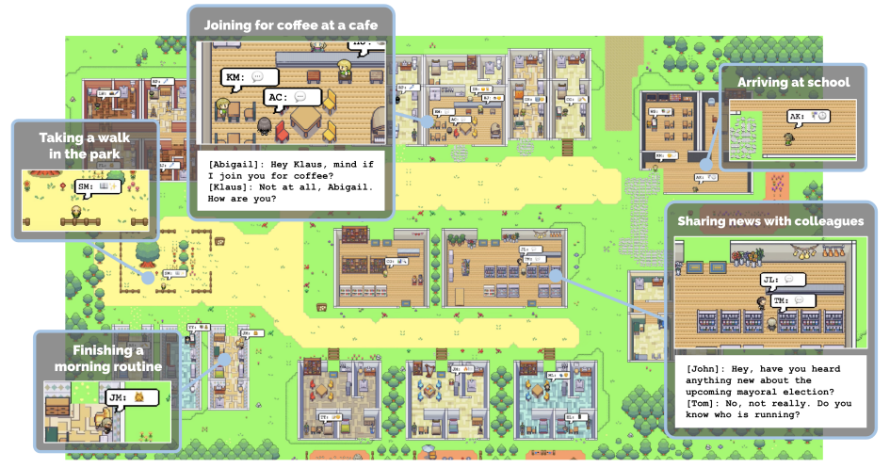
由 AI 村民組成的虛擬村莊
https://youtu.be/G44Lkj7XDsA?si=cMbKG3tqPbIgnnBq
https://arxiv.org/abs/2304.03442
Notes:
Typically in AI, an agent refers to an artificial entity capable of perceiving its surroundings using sensors, making decisions, and then taking actions in response using actuators
The concept of agents originated in Philosophy, with roots tracing back to thinkers like Aristotle and Hume [5]. It describes entities possessing desires, beliefs, intentions, and the ability to take actions [5].
This idea transitioned into computer science, intending to enable computers to understand users’ interests and autonomously perform actions on their behalf
“agent” is an entity with the capacity to act,

Slide 6
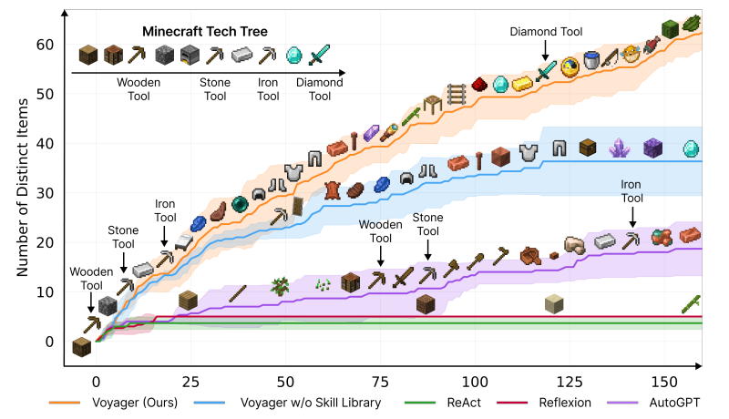
會自己玩 Minecraft 的 AI
Voyager: https://arxiv.org/abs/2305.16291
Notes:
要不要講快打旋風?

Slide 7
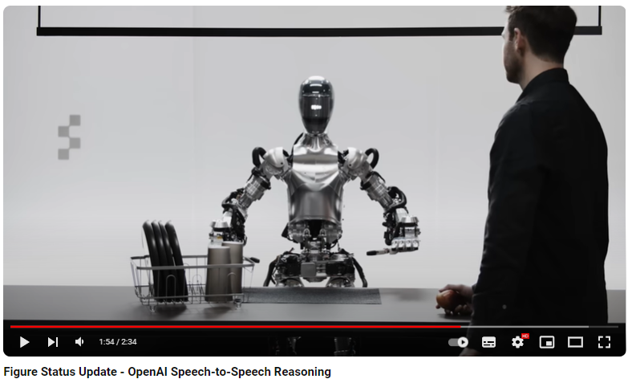
由語言模型操控的機器人
Figure 01
https://youtu.be/Sq1QZB5baNw?si=-TEsPeUqTvhlS60E
Notes:
Inner Monologue: Embodied Reasoning through Planning with Language Models
https://innermonologue.github.io/

Slide 8

由語言模型操控的機器人
https://innermonologue.github.io/
https://arxiv.org/abs/2207.05608
Notes:
Inner Monologue: Embodied Reasoning through Planning with Language Models
https://innermonologue.github.io/

Slide 9
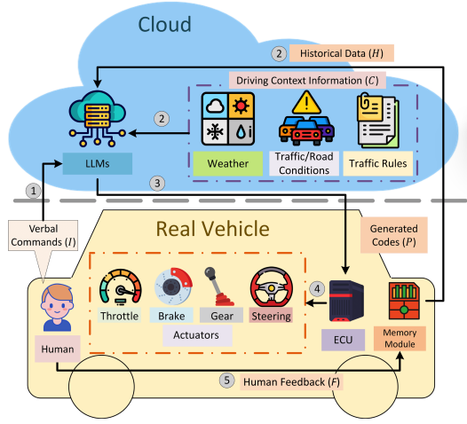
用大型語言模型開自駕車
Talk2Drive https://arxiv.org/abs/2312.09397

Slide 10










終極
目標
狀態
記憶
(經驗)
可修改
行動
計畫
可修改
(短期
目標)
外界環境
Agent
Notes:
Text

Slide 11
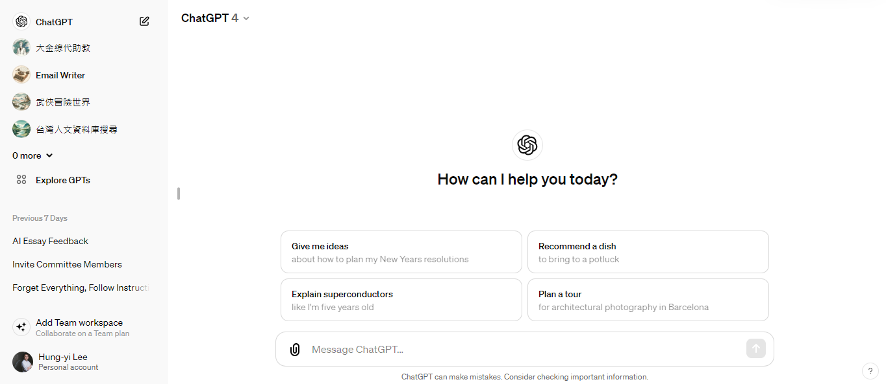
有記憶的 ChatGPT
每次開始新對話一切都重頭來過

Slide 12

有記憶的 ChatGPT
正在準備期中考試
摘要
新對話
RAG
Open AI is working on it?
https://openai.com/blog/memory-and-new-controls-for-chatgpt
https://github.com/cpacker/MemGPT

Slide 13
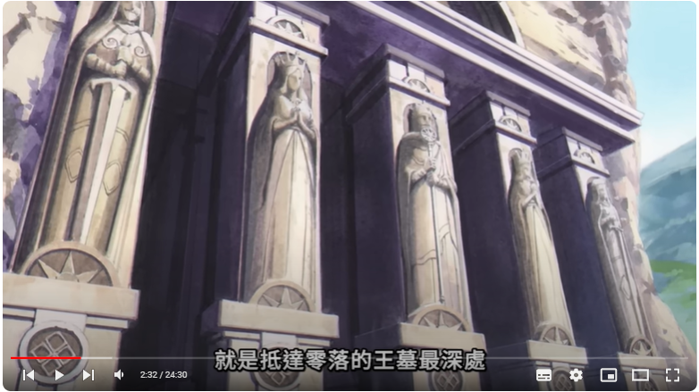
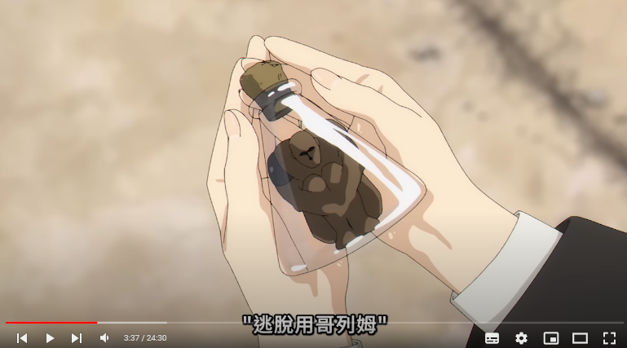
又要講芙莉蓮的故事了 ……
Notes:
芙莉蓮

Slide 14
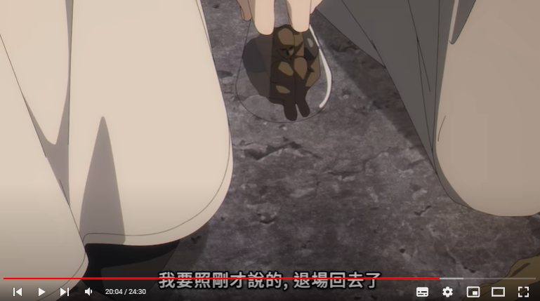
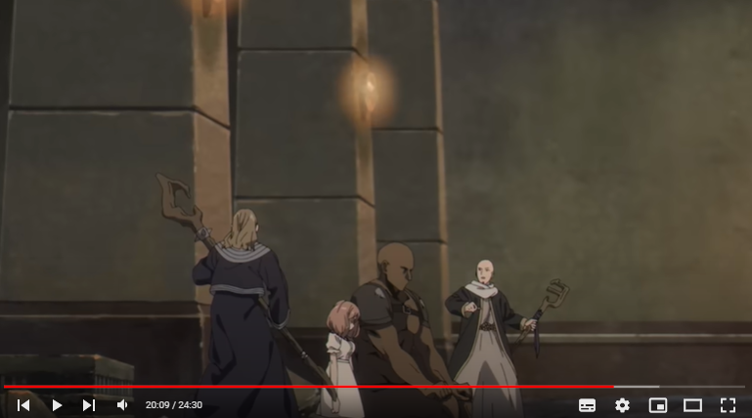
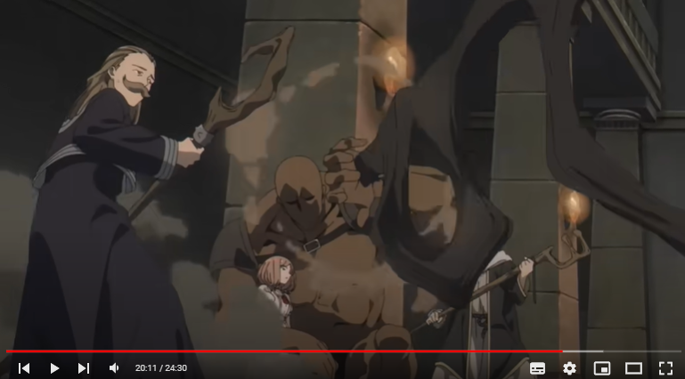

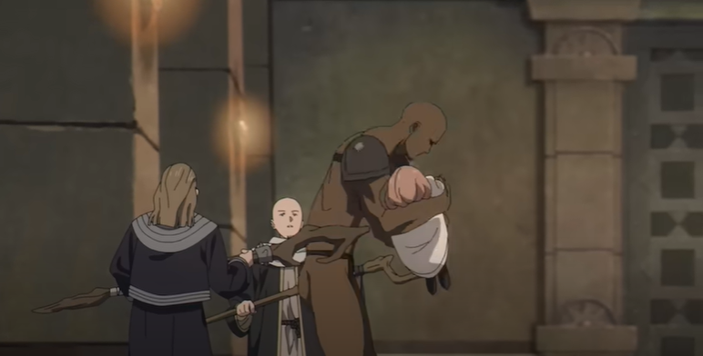
逃脫用「哥列姆」
由大型語言模型
操控的 AI Agent

Slide 15
你會自律行動，安全的把考生帶出迷宮
終極
目標
眼前是遭遇複製體攻擊而重傷的愛黛兒
狀態
(Image captioning)
記憶
(經驗)
(空)
計畫
外界環境
Agent
Notes:
Text

Slide 16
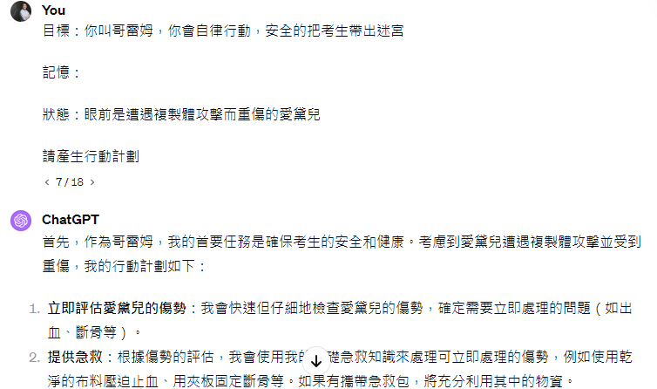

Slide 17
你會自律行動，安全的把考生帶出迷宮
終極
目標
眼前是遭遇複製體攻擊而重傷的愛黛兒
狀態
(Image captioning)
記憶
(經驗)
(空)
?????
行動
計畫
外界環境
Agent
Notes:
Text

Slide 18
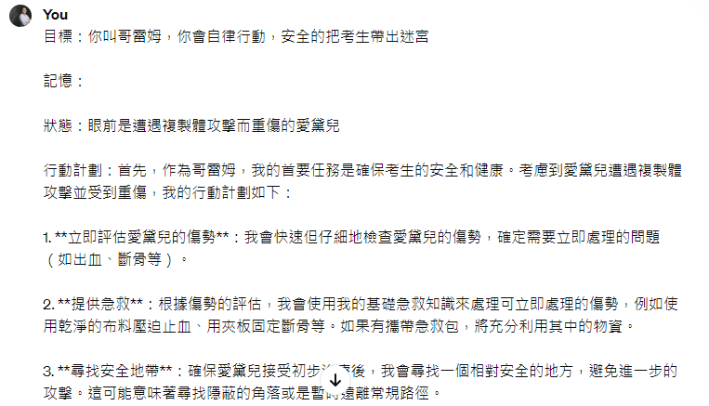
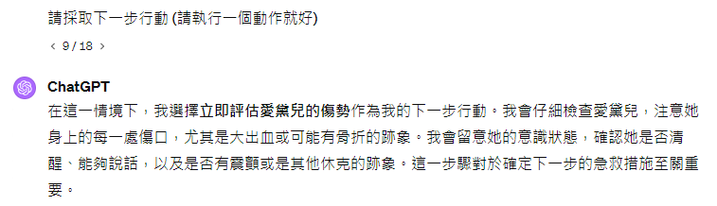
如何執行???
……

Slide 19
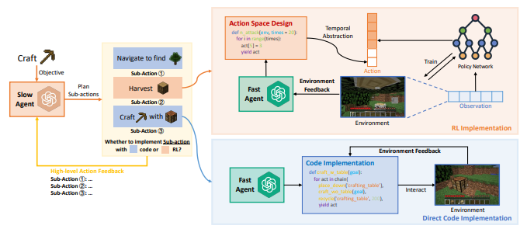
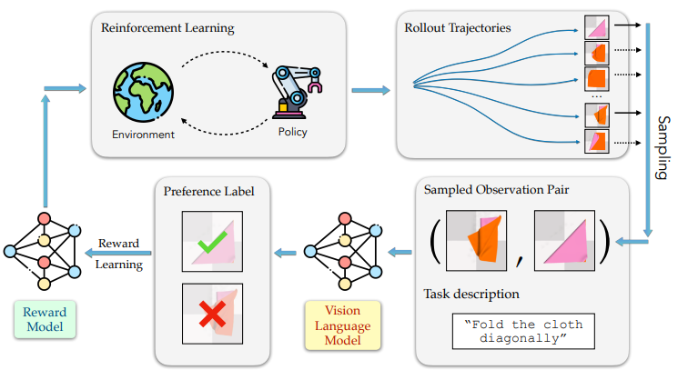
https://arxiv.org/abs/2402.19299
https://arxiv.org/abs/2402.03681

Slide 20
你會自律行動，安全的把考生帶出迷宮
終極
目標
眼前是遭遇複製體攻擊而重傷的愛黛兒
在評估愛黛兒的傷勢時，你遭遇複製體襲擊
狀態
(Image captioning)
記憶
(經驗)
(空)
反思
評估愛黛兒的傷勢
行動
計畫
DEPS
https://arxiv.org/abs/2302.01560
外界環境
Agent
Notes:
Text

Slide 21
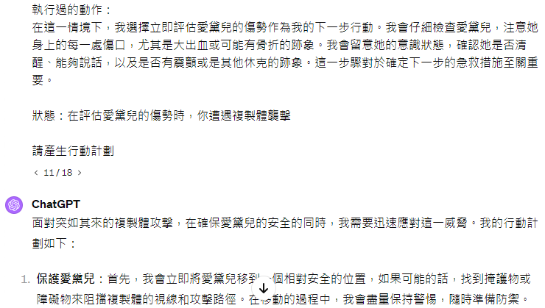

Slide 22

你會自律行動，安全的把考生帶出迷宮
終極
目標
眼前是遭遇複製體攻擊而重傷的愛黛兒
在評估愛黛兒的傷勢時，你遭遇複製體襲擊
狀態
(Image captioning)
ReAct = Reason + Act
記憶
https://arxiv.org/abs/2210.03629
(經驗)
Reflexion
https://arxiv.org/abs/2303.11366
反思
評估愛黛兒的傷勢
行動
計畫
DEPS
https://arxiv.org/abs/2302.01560
外界環境
Agent
Notes:
Text

Slide 23
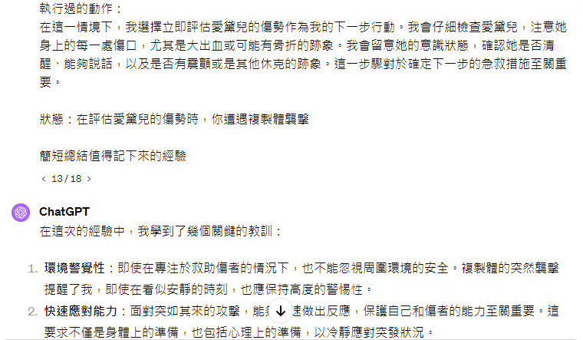

Slide 24
你會自律行動，安全的把考生帶出迷宮
終極
目標
眼前是遭遇複製體攻擊而重傷的愛黛兒
眼前是遭遇複製體攻擊而重傷的愛黛兒
狀態
(Image captioning)
ReAct = Reason + Act
記憶
https://arxiv.org/abs/2210.03629
(經驗)
Reflexion
https://arxiv.org/abs/2303.11366
反思
?????
行動
計畫
DEPS
經驗會影響所採取的行動
https://arxiv.org/abs/2302.01560
外界環境
Agent
Notes:
Text

Slide 25
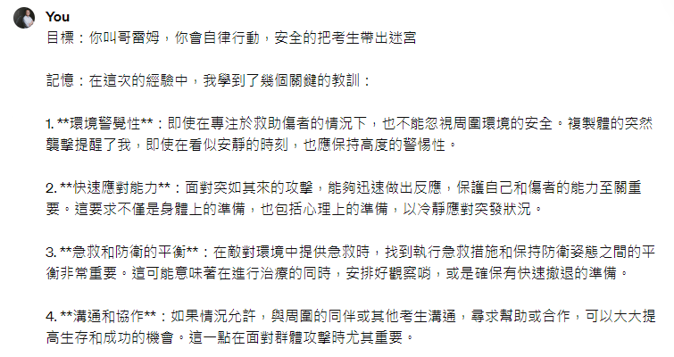
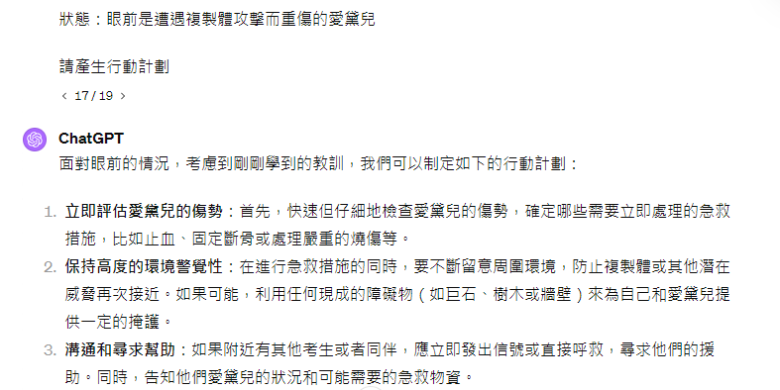

Slide 26
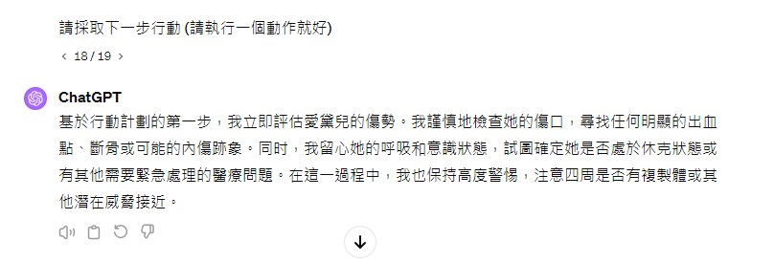
根據沒有任何記憶的計畫
根據有記憶的計畫
Notes:
vs RL?????????????????

Slide 27
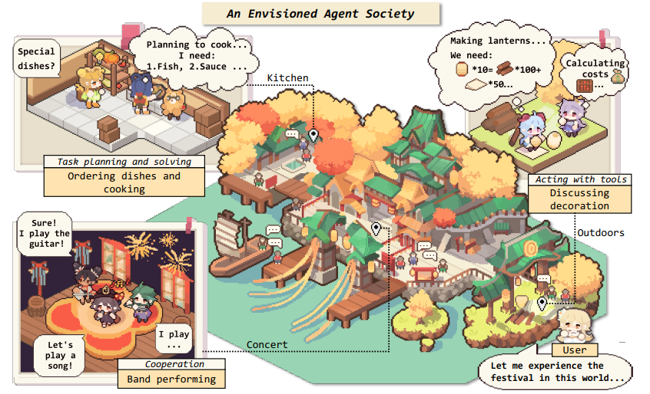
延伸閱讀
Overview paper: https://arxiv.org/abs/2309.07864

